Slide 1

Title: Scalable Multi-Agentic Sentiment Analysis with A2A, MCP, and ML Agents
Subtitle: A Cloud-Native Deployment for Twitter and iPhone Review Understanding Group: Project Team - 9
Team Members:
Gangadhar Singh Shiva
Ananya Chandraker
Mohd Sharik
Date: June 2025

Slide 2
Business Goals and Objectives
Goal: Classify user sentiment from Twitter posts and iPhone reviews at scale for both enterprises and consumer customers.
Need: Organizations struggle with scattered ML pipelines and lack of intelligent routing.
Solution: Develop an intelligent, modular system that classifies sentiment across multiple sources.
Enable scalability and low-latency inference through distributed deployment.
Empower agents to operate independently while routing intelligently via a central orchestrator.
Deliver a fully deployable system on Docker/Kubernetes cloud infrastructure.

Slide 3
Project Dataset Summary
iPhone Review Dataset
Source: Amazon product reviews
Fields: reviewDescription, ratingScore
Label derivation: Rating 1–2 → Negative, 3 → Neutral, 4–5 →
Positive Neutral, Negative
Twitter Dataset
Source: Pre-labeled tweets with sentiment classification (Positive, Negative, Neutral).
Size: ~75,000 samples
Fields: Tweet ID, Entity, Sentiment, Tweet Content

Slide 4
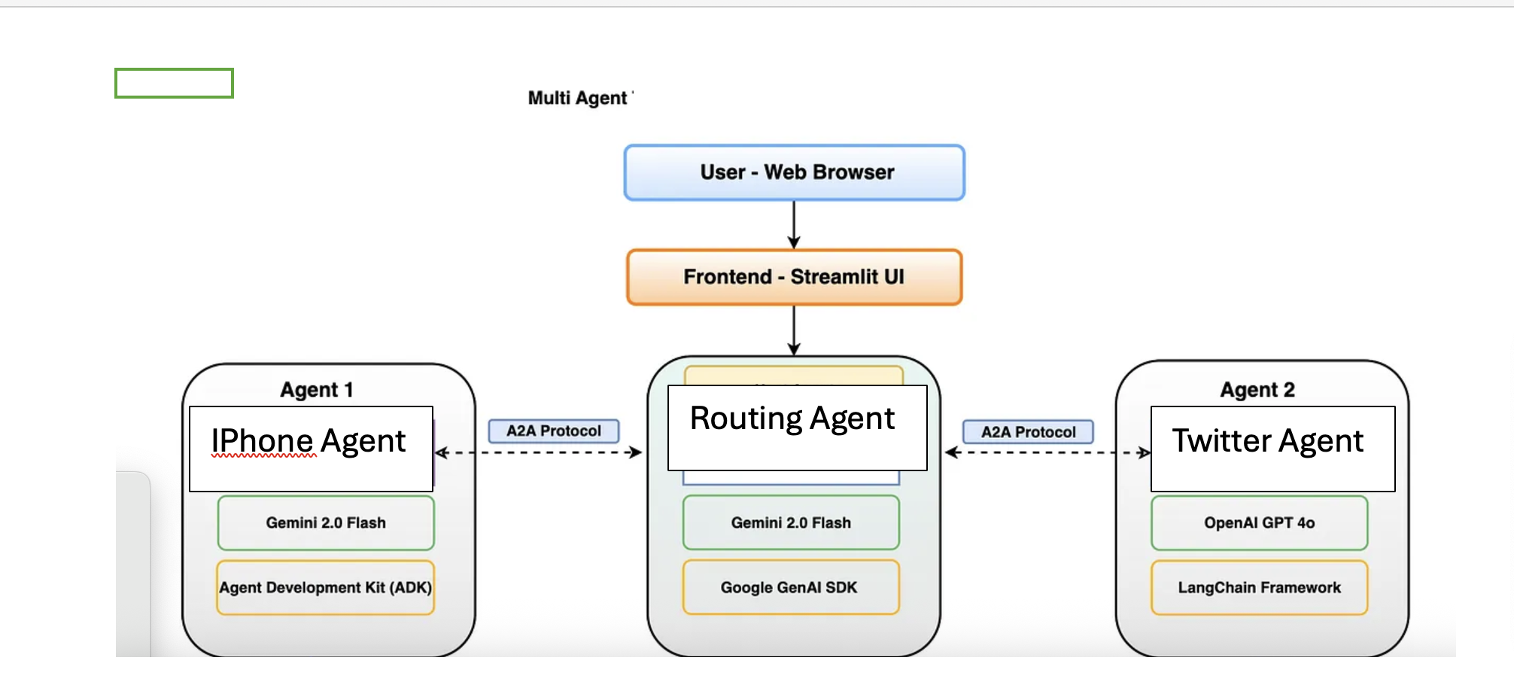
System Architecture
Agent | Model | Input | Output
iPhone Agent | Random Forest / TextBlob | Review text | Sentiment
Twitter Agent | BERTweet | Tweet content | Sentiment
Router Agent | Keyword/Embedding | Query | Routes to Agent
MCP Server | FastMCP | Agent requests | Manages routing/Sentiments

Slide 5
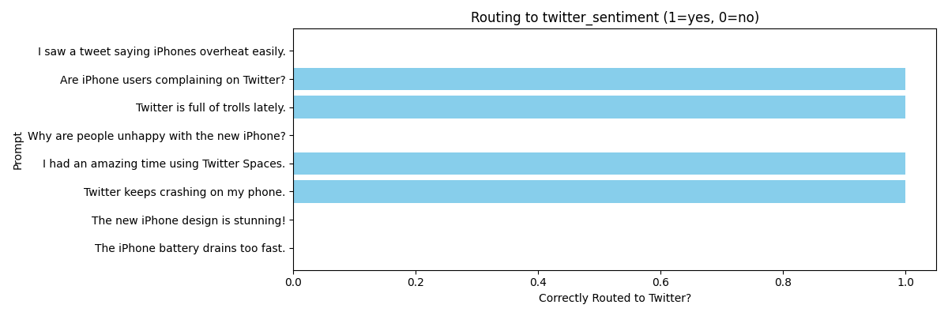
Performance Metrics

Slide 6
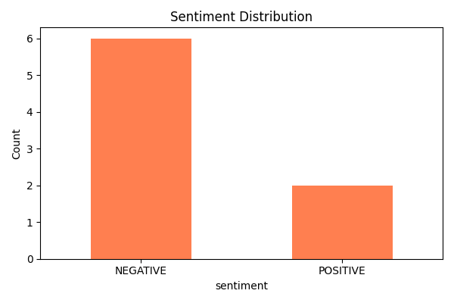
Performance Metrics
Agent | Accuracy | Notes
iPhone ML Agent | ~86% | RF + TF-IDF
Twitter BERT Agent | ~88% | BERTweet fine-tuned
Routing Accuracy | 100% | On test queries

Slide 7
System Architecture (ML Model)
ML Models
Twitter Agent: Fine-tuned BERTweet Transformer (HuggingFace)
a2a_twitter_sentiment_agent.py handles loading the model, tokenizing input, and returning prediction
Uses Hugging Face's AutoModelForSequenceClassification
Optimized for short-text sentiment classification
Example Query: "Twitter keeps crashing on my phone."
Output: Negative sentiment with ~88% classification confidence

Slide 8
System Architecture (ML Model)
ML Models
iPhone Agent: Random Forest with TF-IDF vectorization and optional TextBlob sentiment analysis
a2a_iphone_sentiment_agent.py loads review CSVs, vectorizes reviews, applies RandomForestClassifier
Sentiment is derived from Amazon star ratings and review content
Alternative lightweight path uses TextBlob polarity scoring
Example Query: "The iPhone battery drains too fast."
Output: Negative sentiment (probability from RF classifier or polarity < -0.1 from TextBlob)
Routing Agent Uses keyword classification or sentence embeddings to identify target agent
a2a_main.py uses mcp.call(tool_name, input) to route user query
Routing Accuracy observed: 100% in test samples
Uses keyword classification or sentence embeddings to identify target agent
a2a_main.py uses mcp.call(tool_name, input) to route user query
Routing Accuracy observed: 100% in test samples

Slide 9
System Architecture (ML Model)
ML Models
Routing Agent Uses keyword classification or sentence embeddings to identify target agent
a2a_main.py uses mcp.call(tool_name, input) to route user query
Routing Accuracy observed: 100% in test samples
Uses keyword classification or sentence embeddings to identify target agent
a2a_main.py uses mcp.call(tool_name, input) to route user query
Routing Accuracy observed: 100% in test samples

Slide 10
System Architecture (MCP) Workflow
MCP Client and Server Integration
The system is structured such that the MCP server listens for function calls from agent clients. MCP clients act as wrappers for the agents and route communication using either standard input/output (for terminal-based tools) or HTTP. The client uses schema definitions and registered MCP decorators (@mcp.tool) to facilitate execution.
MCP Server: Hosts service registration, manages message routing, handles execution lifecycle.
MCP Client: Sends query via CLI or embedded API (e.g., FastMCP.run("tool_name", input))
Embedding Support: For routing, sentence transformers or keyword-based vector encoders are used to transform queries into semantic space and match the most appropriate agent.

Slide 11
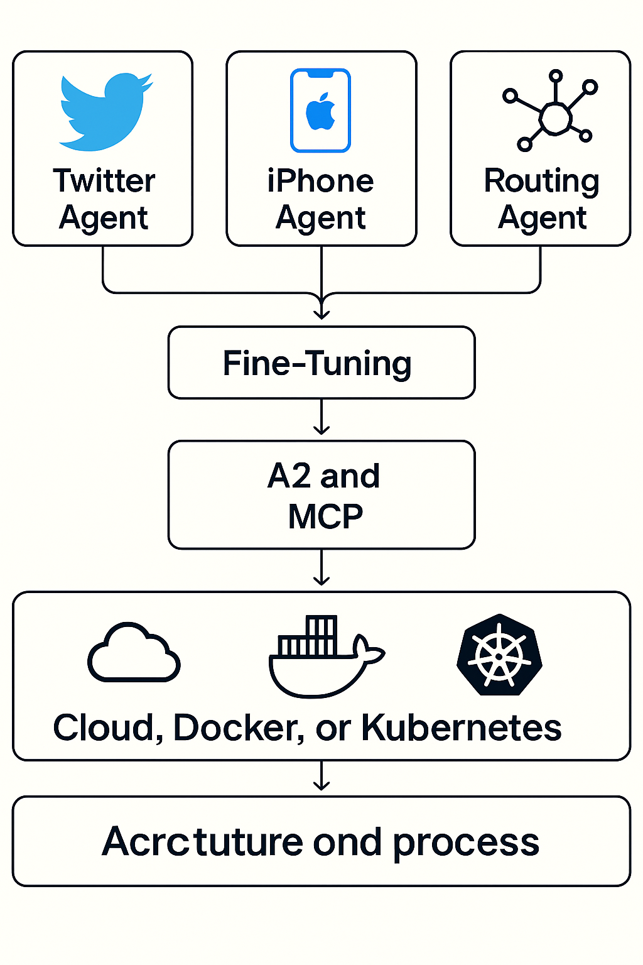
Deployment Strategy
Containerized with Docker
Microservices on Kubernetes
Option for FastAPI-based REST
Deployable via Helm or
Docker Compose

Slide 12
Summarize
Modular agents for domain-specific sentiment MCP for orchestration
A2A for clean tool communication
ML, LLM for Sentimental Analysis
Architecture can power scalable, domain-aware AI assistants — whether for enterprise analytics, customer service, or real-time monitoring.

Slide 13
Thank you

